Slide 1

Fine-Tuning Models Part 6

Slide 2
What We Will Cover
Understanding Pre-Training
Understanding Fine-Tuning
When to Use Fine-Tuning
Preparing Training Data
Cost Calculations
Train / Test Split
Creating Fine-Tuning Jobs
Revisiting Hyperparameters
Analyzing the Training Metrics
Integrations
Exploring Fine-Tuning Jobs
Understanding Checkpoints
Exploring Fine-Tuning Events
Using Fine-Tuned Models
Fine-Tuning Use Cases
Continued Fine-Tuning
Practical Examples

Slide 3
Analyzing the Training Metrics

Slide 4
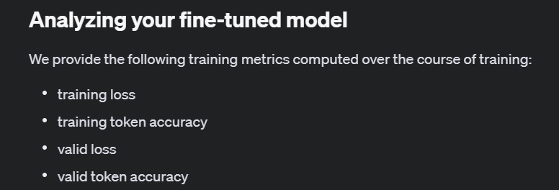
Notes:
https://platform.openai.com/docs/guides/fine-tuning/analyzing-your-fine-tuned-model

Slide 5
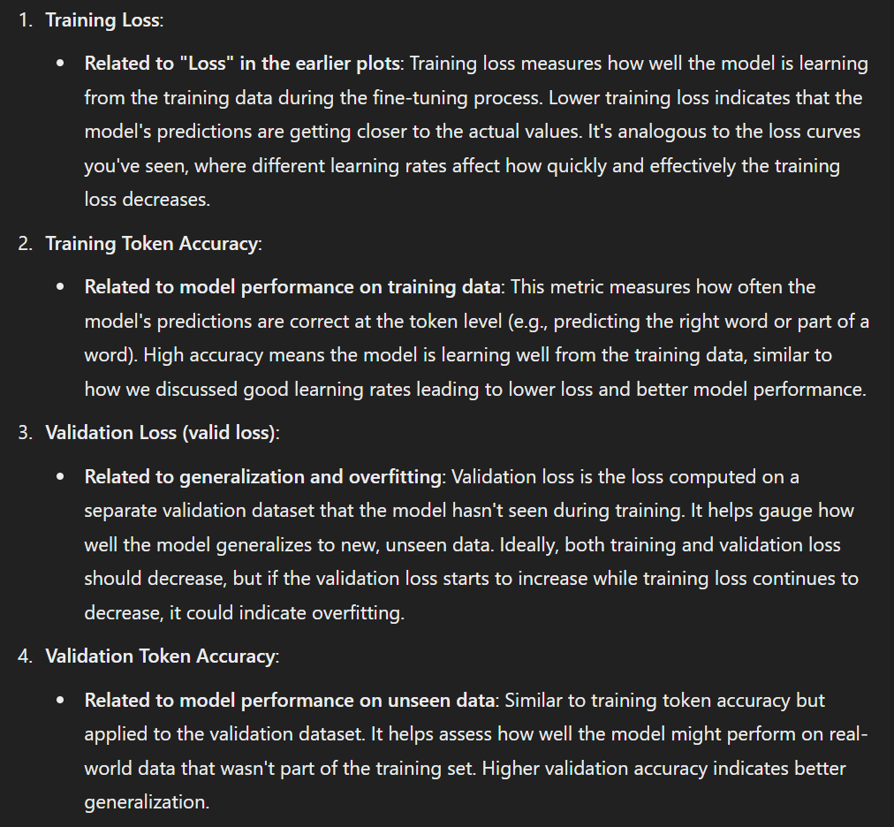

Slide 6
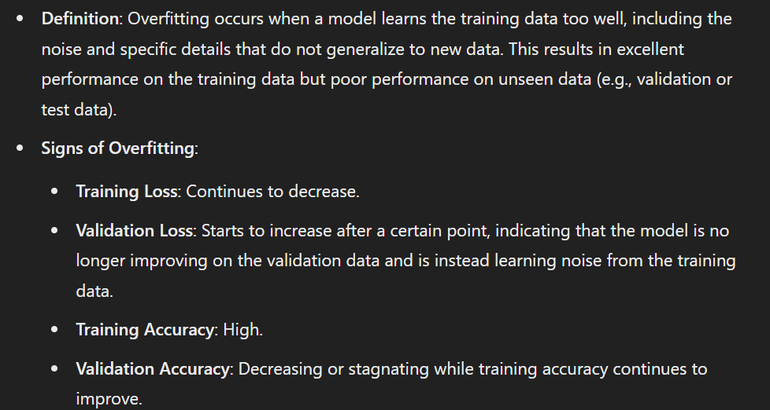
Overfitting

Slide 7
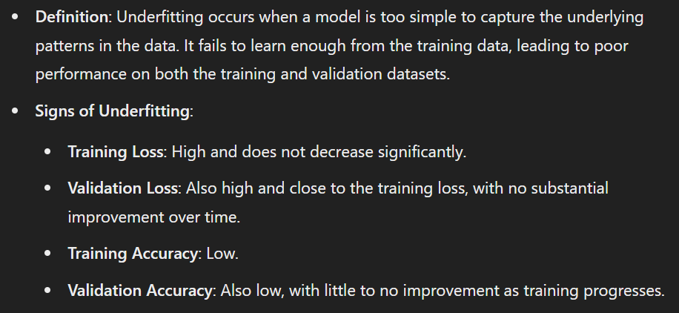
Underfitting

Slide 8
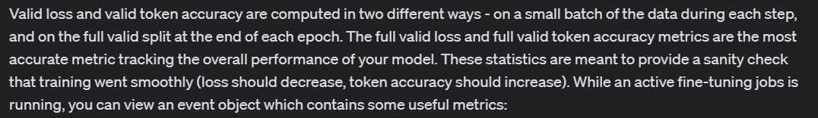
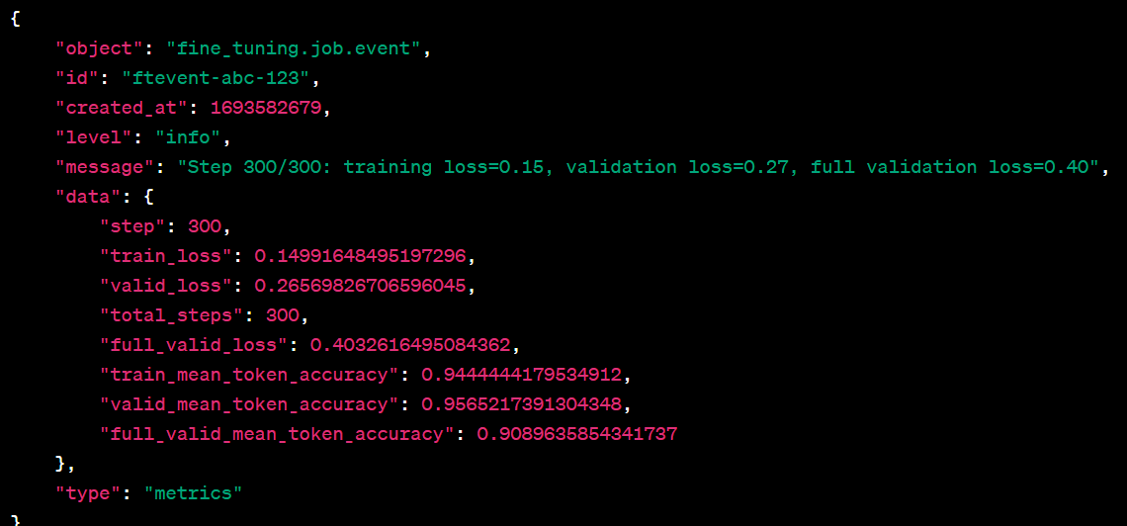

Slide 9
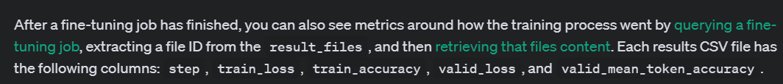
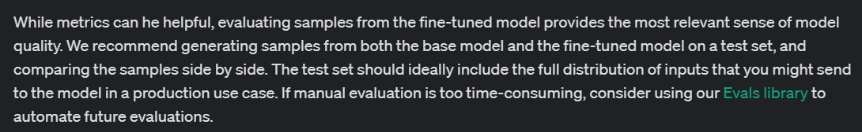

Slide 10
Demo: Pulling Training Metrics Data
def fetch_and_process_fine_tuning_metrics(client, fine_tuning_job_id):
# Function to replace colons with underscores for file names
def replace_colons_with_underscores(input_string):
return input_string.replace(':', '_')
# Get the training metrics for the fine-tuning job
fine_tune_job = client.fine_tuning.jobs.retrieve(fine_tuning_job_id)
# File ID of the file you want to download
file_id = fine_tune_job.result_files[0]
# Retrieve the file content directly
response = client.files.content(file_id)

Slide 11
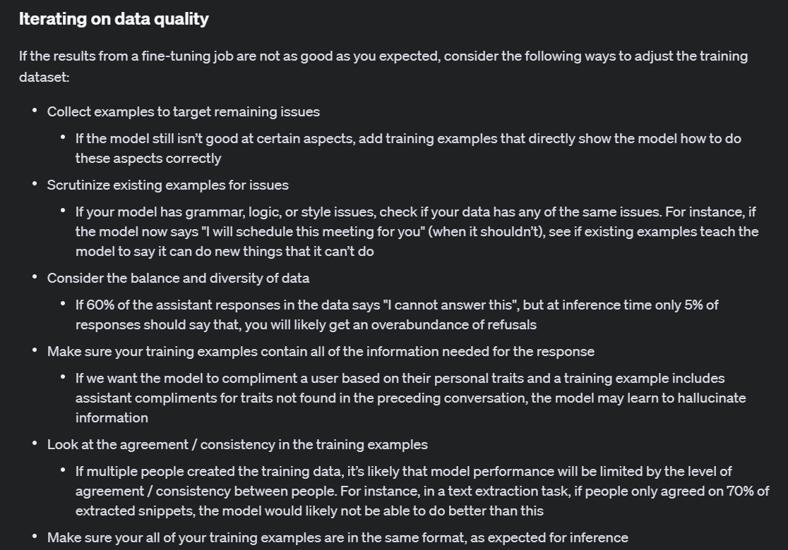
Notes:
https://platform.openai.com/docs/guides/fine-tuning/iterating-on-data-quality

Slide 12
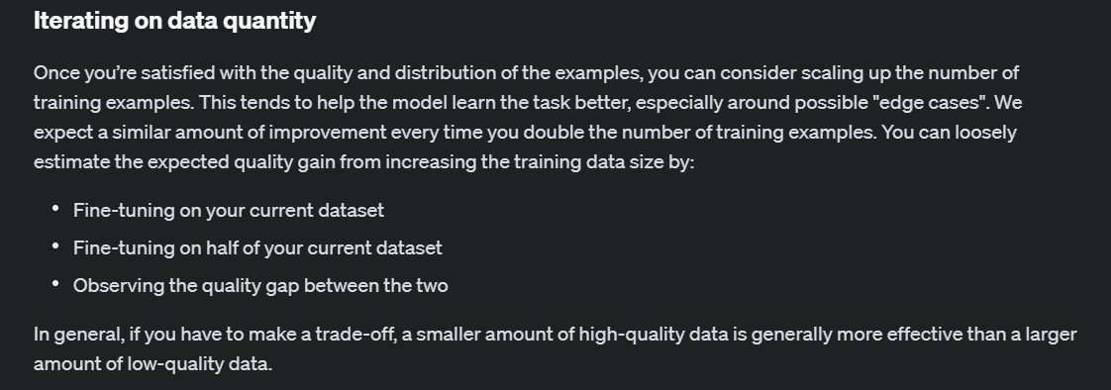
Notes:
https://platform.openai.com/docs/guides/fine-tuning/iterating-on-data-quantity

Slide 13
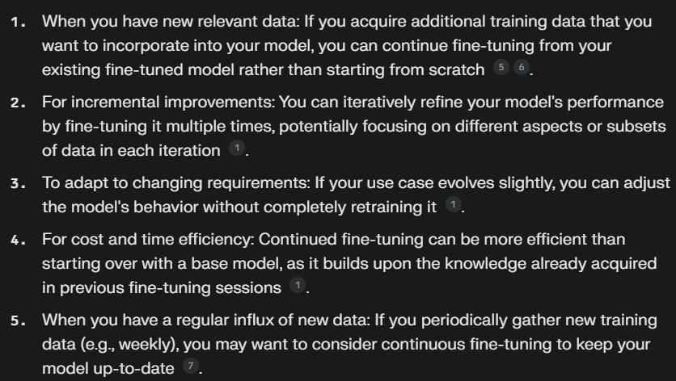
Continued Fine-Tuning “Fine-Tuning with a Fine-Tuned Model”

Slide 14
Continued Fine-Tuning Steps
Create a fine-tuning job.
Get your fine-tuned model.
Assess performance.
Create a fine-tuning job on the fine-tuned model.
Get your new fine-tuned model.
Assess performance.

Slide 15
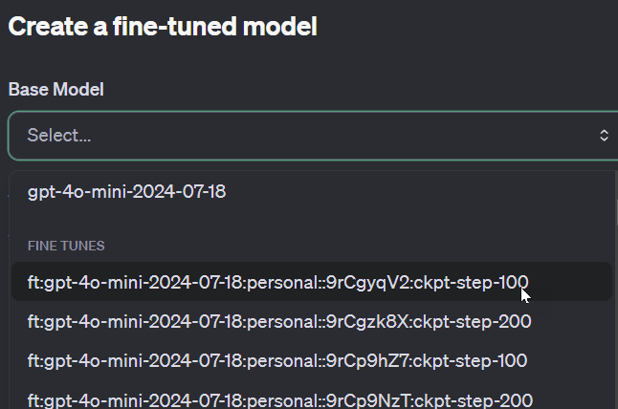
Demo: Continued Fine-Tuning (UI)

Slide 16



Notes:
https://www.youtube.com/channel/UC35ZpwldGw7ZJ5R-2sLijzw

Slide 17
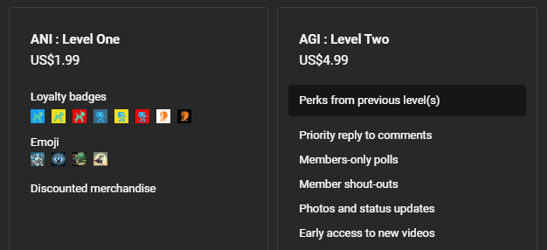

Membership has its privileges
Notes:
https://www.youtube.com/channel/UC35ZpwldGw7ZJ5R-2sLijzw/join

Slide 18

https://www.youtube.com/@AINewsFresh

Slide 19

Integrations

Slide 20
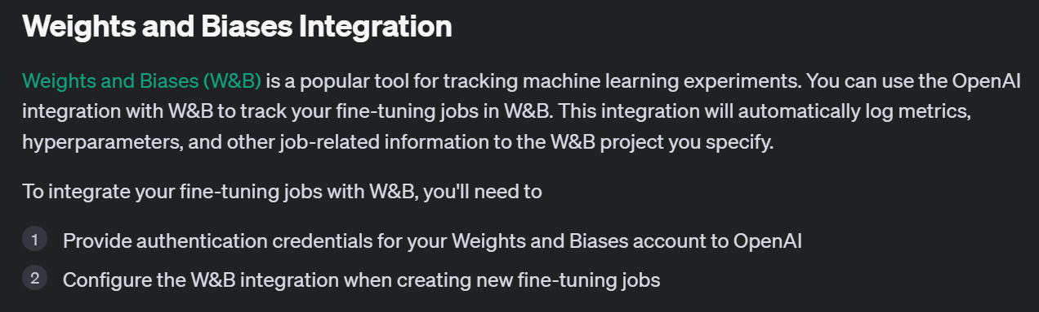
Notes:
https://platform.openai.com/docs/guides/fine-tuning/weights-and-biases-integration

Slide 21
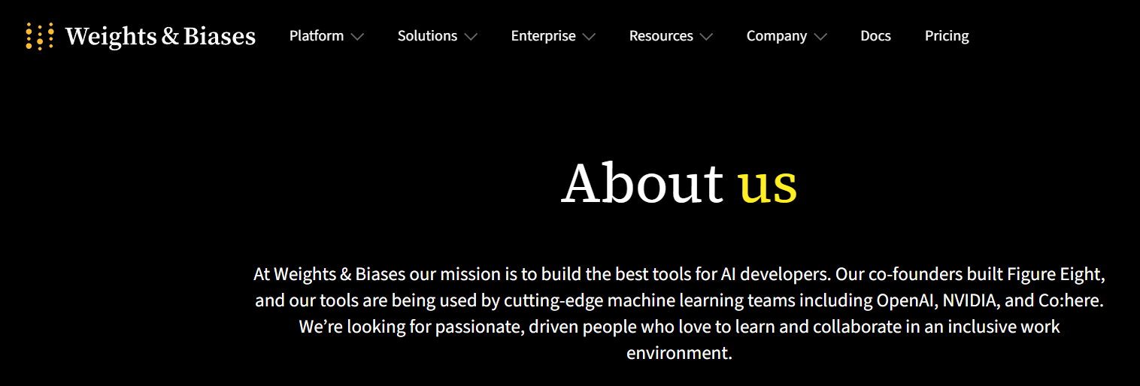
Notes:
https://wandb.ai/site/company/about-us

Slide 22
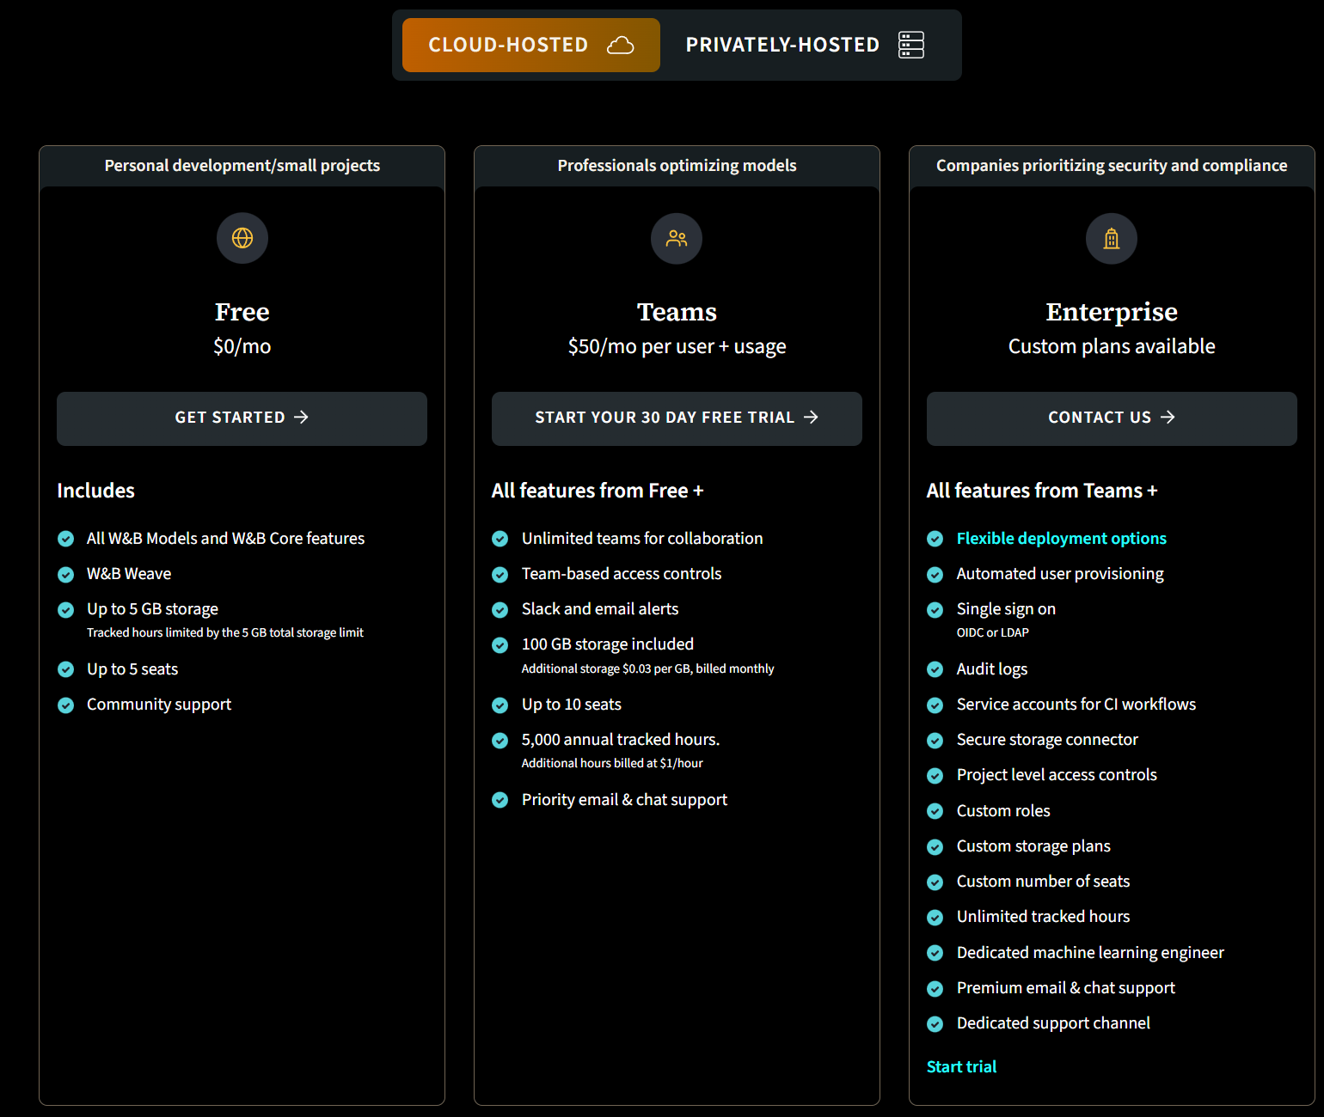
Notes:
https://wandb.ai/site/pricing

Slide 23
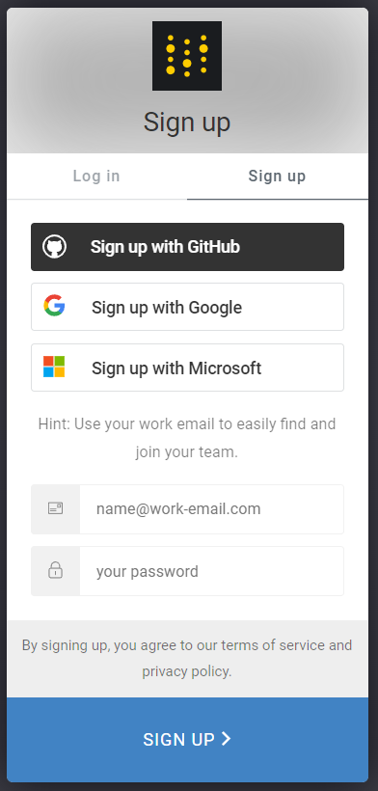

Notes:
https://wandb.ai/site

Slide 24
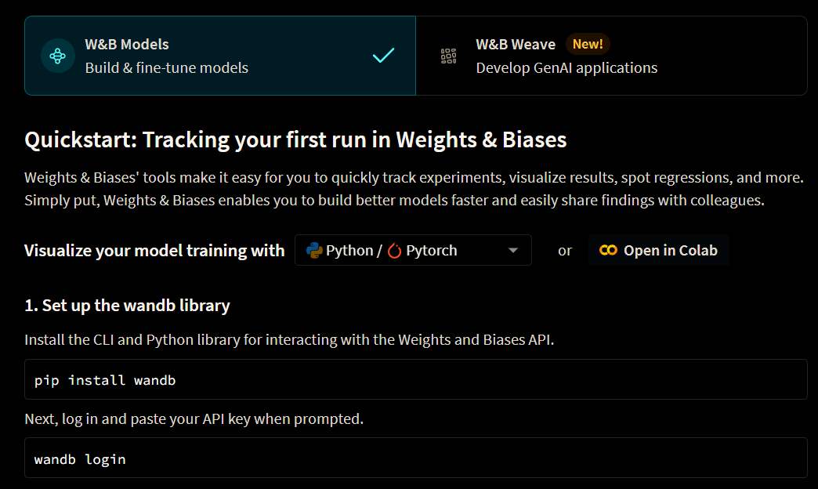
Notes:
https://wandb.ai/home

Slide 25
Demo: Weights & Biases Website
Notes:
https://wandb.ai/home

Slide 26
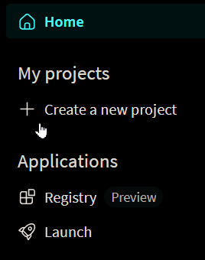
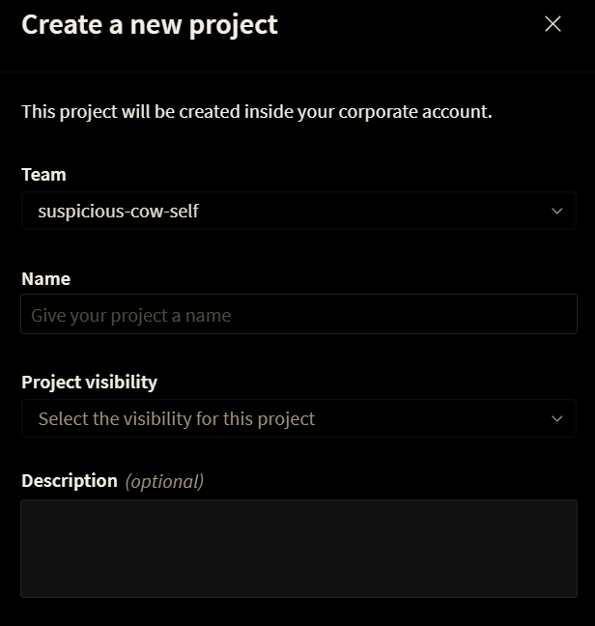

Slide 27
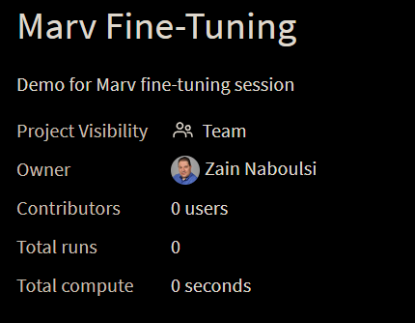
Demo: Creating a Project

Slide 28
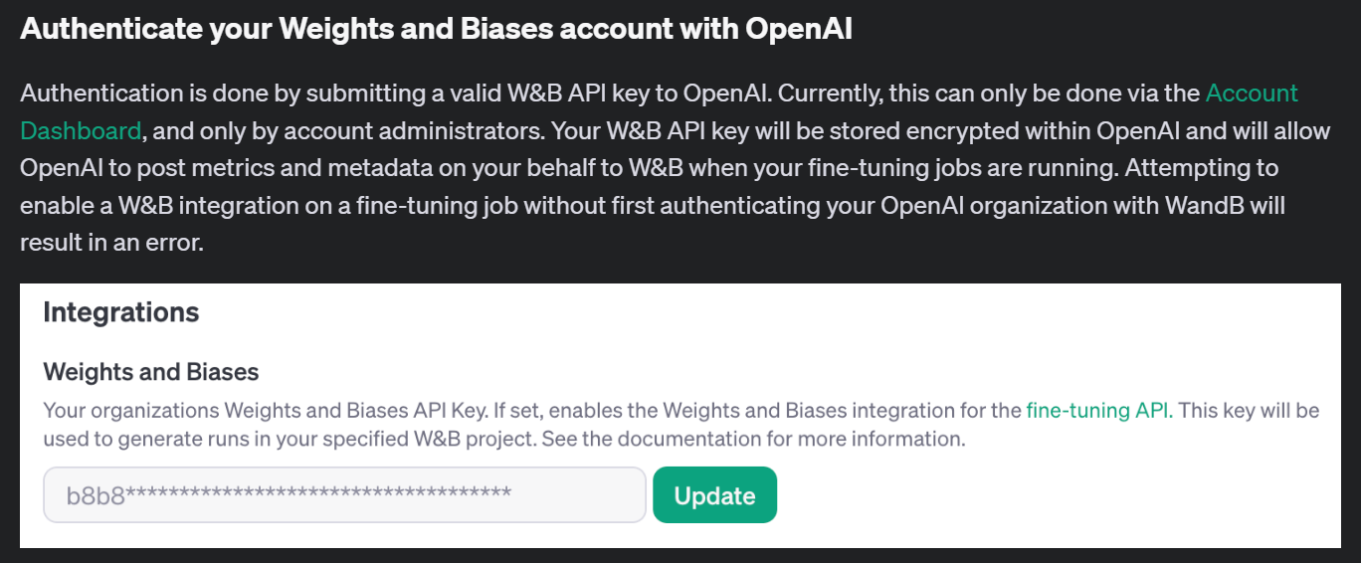
Notes:
https://platform.openai.com/docs/guides/fine-tuning/authenticate-your-weights-and-biases-account-with-openai

Slide 29
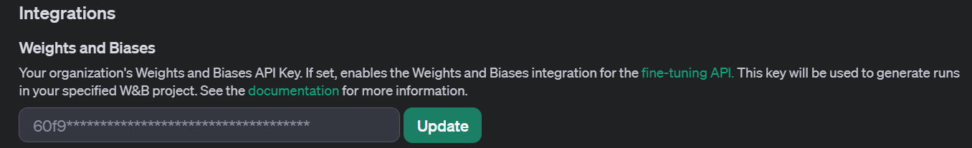
Demo: Authenticate Your W&B Account

Slide 30
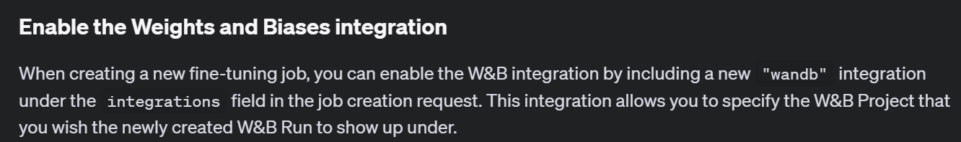
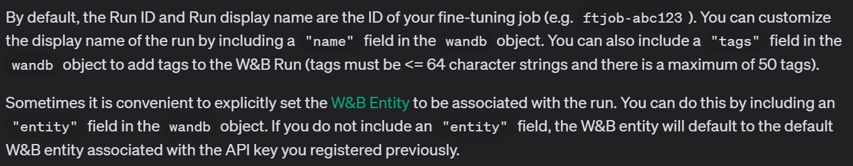
Notes:
https://platform.openai.com/docs/guides/fine-tuning/enable-the-weights-and-biases-integration

Slide 31
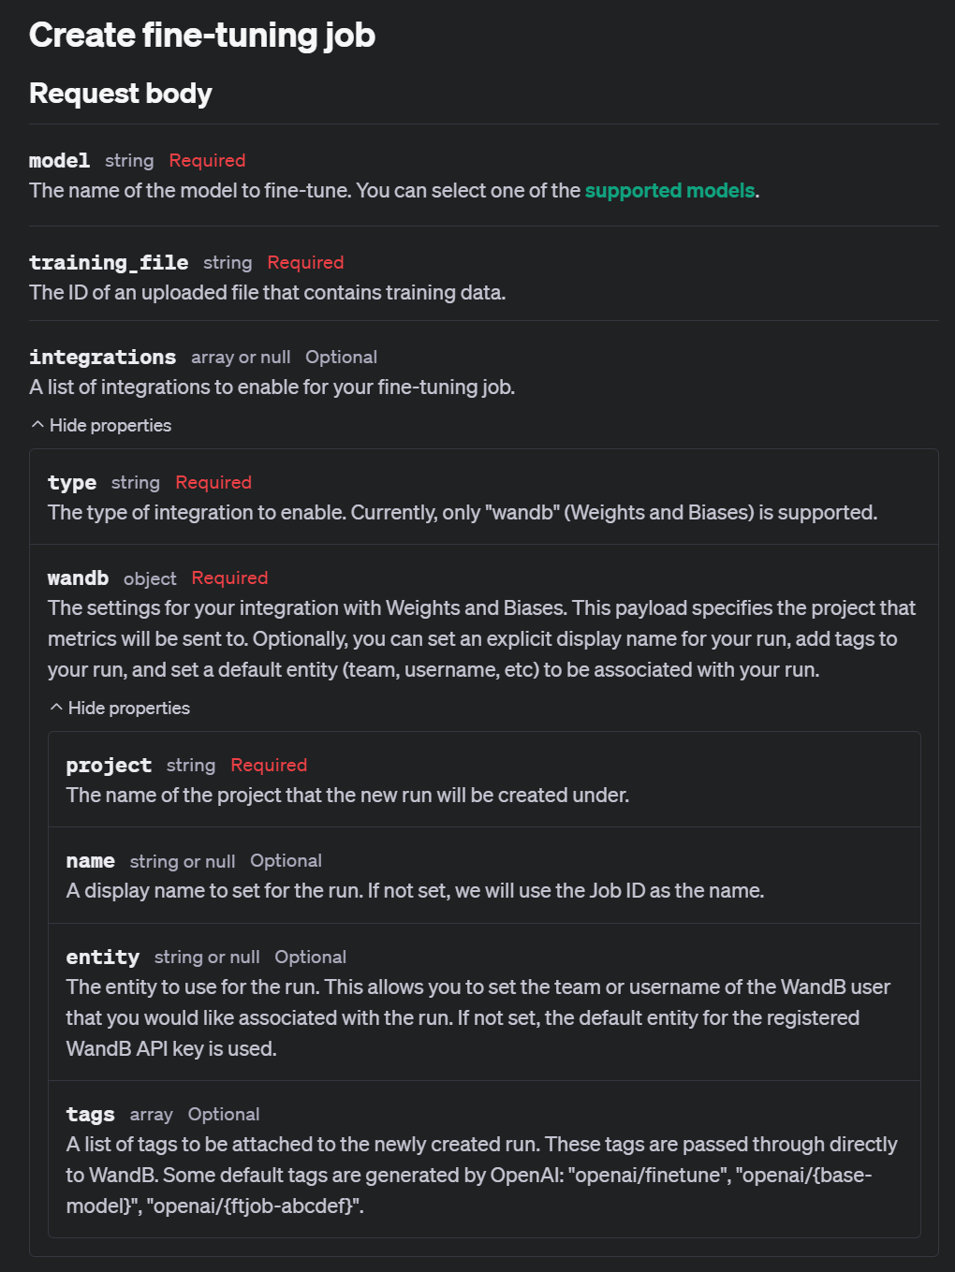
Notes:
https://platform.openai.com/docs/api-reference/fine-tuning/create

Slide 32
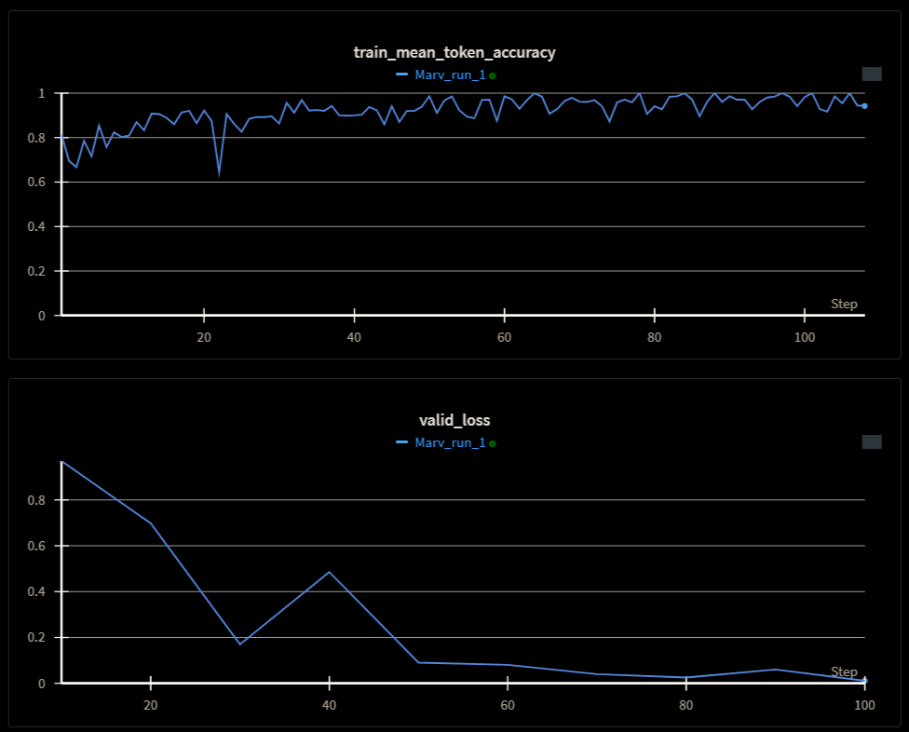
Demo: Create a Fine-Tuning Job with Integration

Slide 33
Exploring Fine-Tuning Jobs

Slide 34
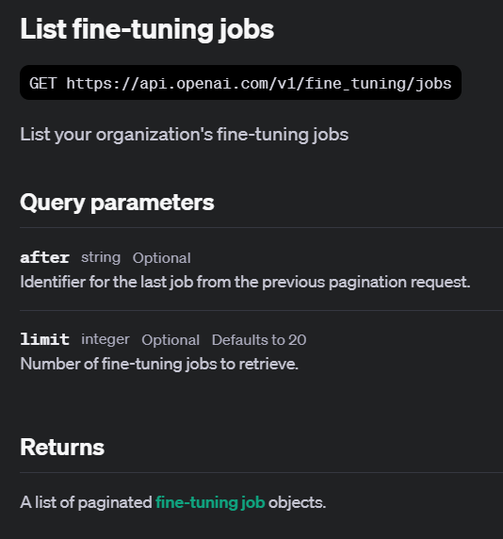
Notes:
https://platform.openai.com/docs/api-reference/fine-tuning/list

Slide 35
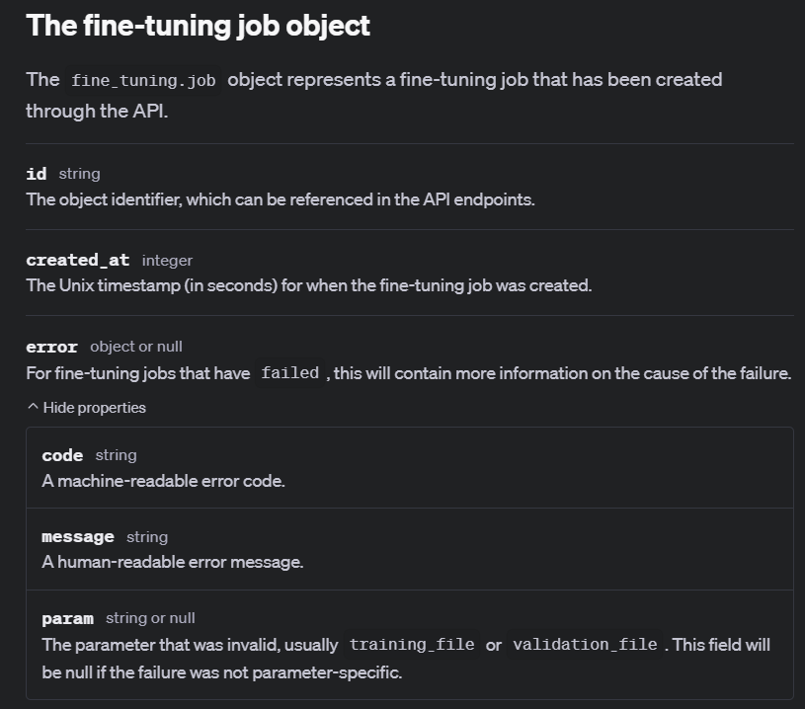
Notes:
https://platform.openai.com/docs/api-reference/fine-tuning/object

Slide 36
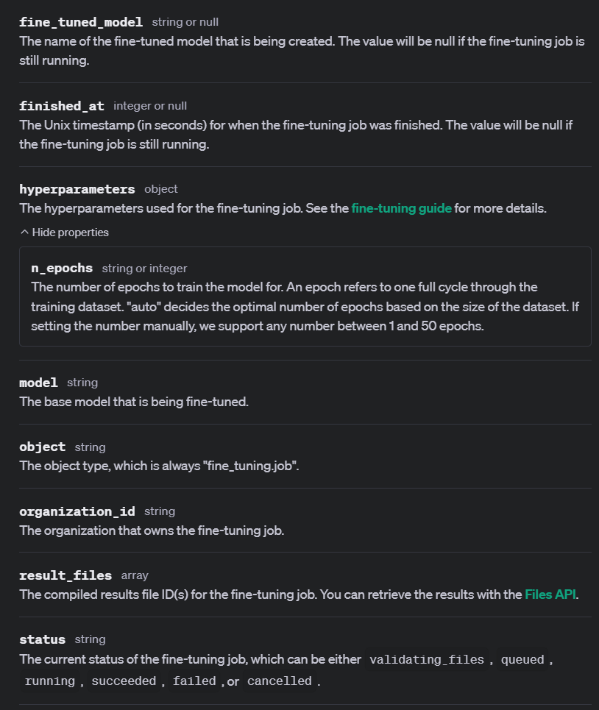
Notes:
https://platform.openai.com/docs/api-reference/fine-tuning/object

Slide 37
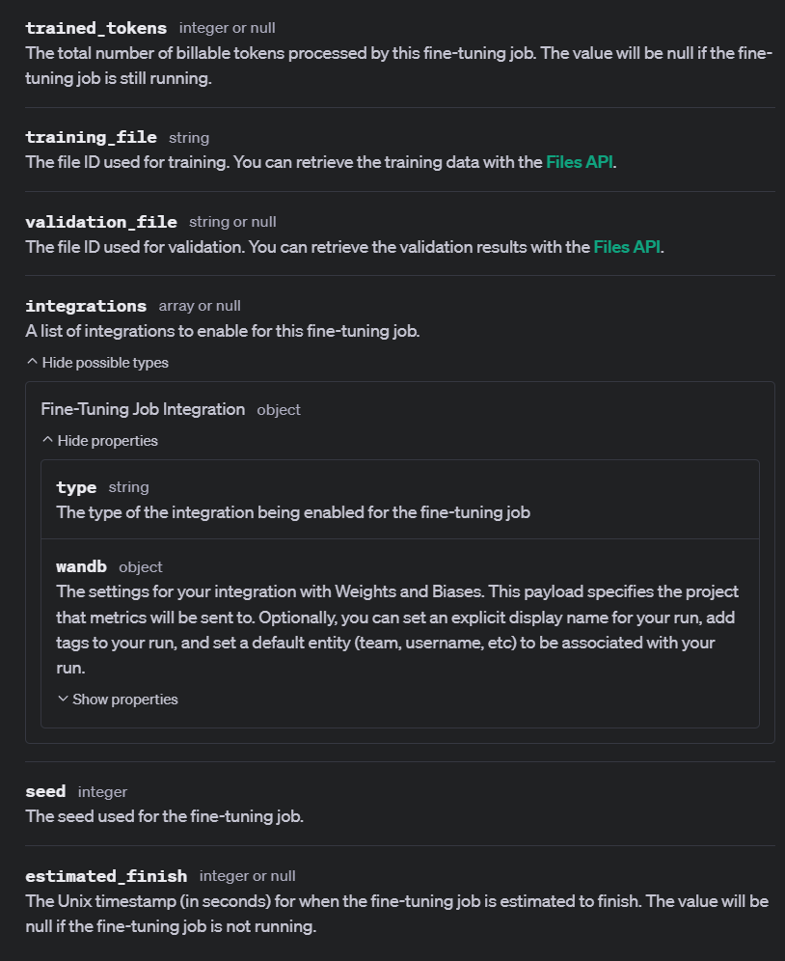

Slide 38
Demo: List Fine-Tuning Jobs
# list our fine-tuning jobs
ft_jobs_list = client.fine_tuning.jobs.list()
for job in ft_jobs_list:
print(job.id, job.object, job.status)

Slide 39
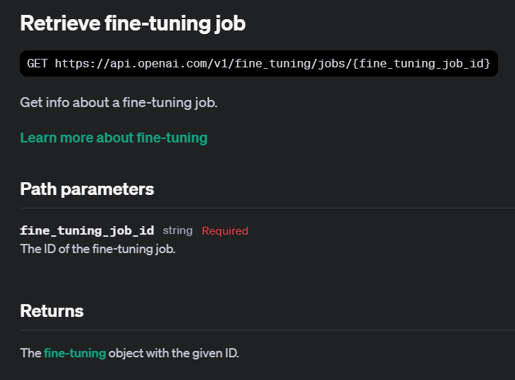
Notes:
https://platform.openai.com/docs/api-reference/fine-tuning/retrieve

Slide 40
Demo: Retrieving Fine-Tuning Jobs
# Retrieve the fine-tuning job by ID
retrieved_job = client.fine_tuning.jobs.retrieve(job.id)

Slide 41
Understanding Checkpoints

Slide 42
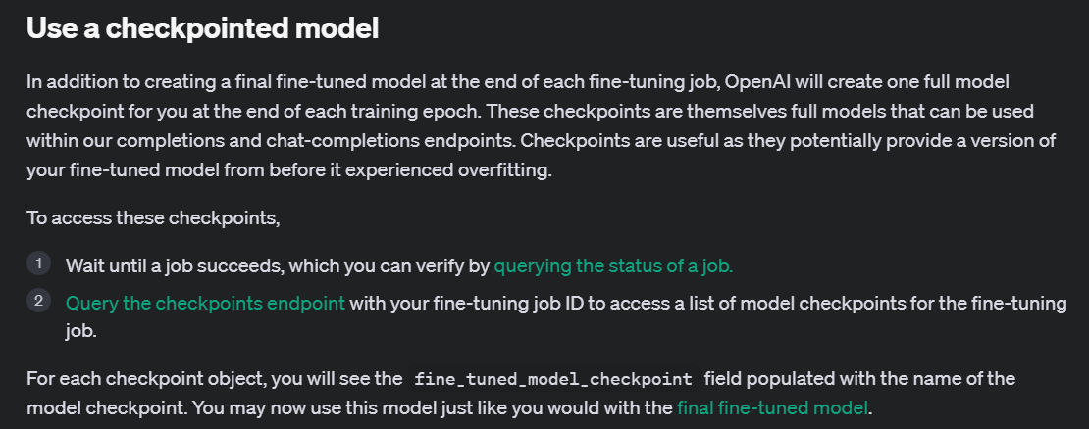
Notes:
https://platform.openai.com/docs/guides/fine-tuning/use-a-checkpointed-model

Slide 43
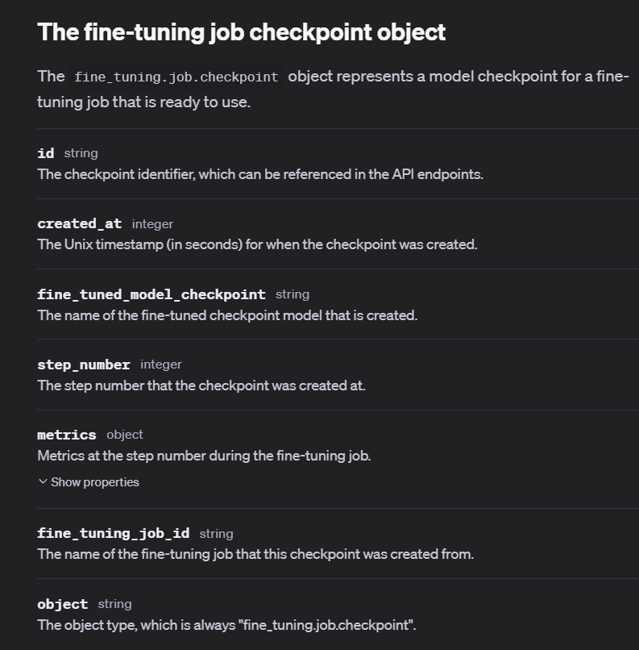
Notes:
https://platform.openai.com/docs/api-reference/fine-tuning/checkpoint-object

Slide 44
Demo: Listing Job Checkpoints
# List all fine-tuning job checkpoints
ft_jobs_checkpoints_list = client.fine_tuning.jobs.checkpoints.list(my_ft_job.id)

Slide 45
Exploring Fine-Tuning Events

Slide 46
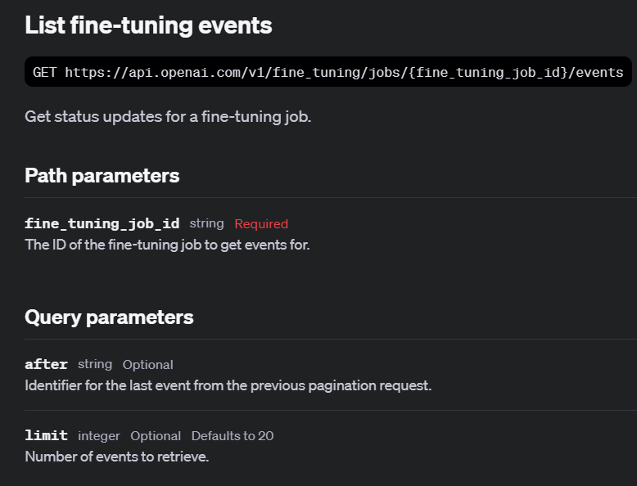
Notes:
https://platform.openai.com/docs/api-reference/fine-tuning/list-events

Slide 47
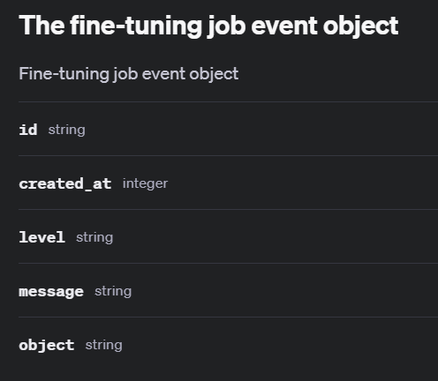
Notes:
https://platform.openai.com/docs/api-reference/fine-tuning/event-object

Slide 48
Demo: List Fine-Tuning Events
# List the events for the first fine-tuning job in our list
ft_events_list = client.fine_tuning.jobs.list_events(
fine_tuning_job_id=job.id,
limit=10
)
for event in ft_events_list.data:
print(event.id, event.object, event.created_at, event.level, event.type, event.message)

Slide 49
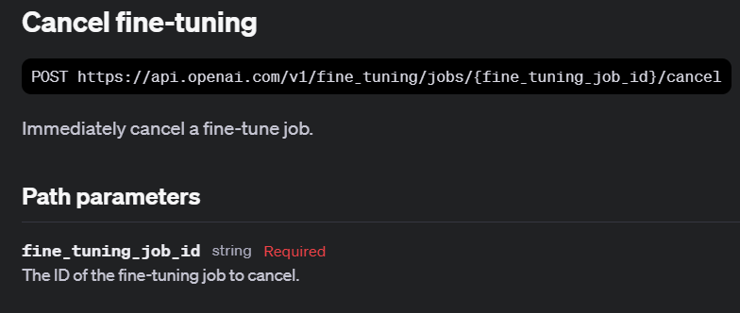
Notes:
https://platform.openai.com/docs/api-reference/fine-tuning/cancel

Slide 50
Demo: Cancelling Fine-Tuning Jobs
# Cancel the fine-tuning job
client.fine_tuning.jobs.cancel(dead_ft_job_walking.id)

Slide 51
Using Fine-Tuned Models

Slide 52
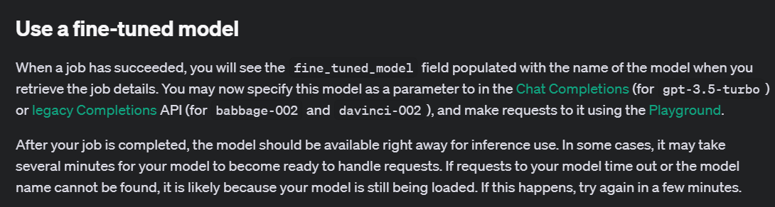
Notes:
https://platform.openai.com/docs/guides/fine-tuning/use-a-fine-tuned-model

Slide 53
Demo: Using Fine-Tuned Models
# Use the fine-tuned model to generate a completion
completion = client.chat.completions.create(
model=“ft:gpt-4o-mini-2024-07-18:personal::9rD1XNCu”,
messages=[
{"role": "system", "content": "Marv is a factual chatbot that is also sarcastic."},
{"role": "user", "content": "What is limburger cheese?"},
]
)
print(completion.choices[0].message.content)

Slide 54
Notes:
https://platform.openai.com/docs/guides/fine-tuning/use-a-checkpointed-model

Slide 55
Demo: Using Checkpointed Models
# Use the checkpointed model to generate a completion
completion = client.chat.completions.create(
model=“ft:gpt-4o-mini-2024-07-18:personal::9rD1XEpY:ckpt-step-200”,
messages=[
{"role": "system",
"content": "Marv is a factual chatbot that is also sarcastic."},
{"role": "user",
"content": "What is limburger cheese?"},
]
)

Slide 56
Fine-Tuning Use Cases

Slide 57
Style and Tone
{"messages": [
{"role": "system", "content": "Marv is a factual chatbot that is also sarcastic."},
{"role": "user", "content": "What's the capital of France?"},
{"role": "assistant", "content": "Paris, as if everyone doesn't know that already."}]}

Slide 58
Structured Output
{"messages":
[{"role": "user",
"content": "What's the weather like in Tokyo right now?"},
{"role": "assistant",
"content": null,
"function_call":
{"name": "get_current_weather",
"arguments": "{\"location\": \"Tokyo, Japan\", \"format\": \"celsius\"}"}},
{"role": "function", "name": "get_current_weather",
"content": "{\"location\": \"Tokyo, Japan\", \"temperature\": 28.5, \"unit\": \"°C\", \"humidity\": 65, \"condition\": \"partly cloudy\"}"},

Slide 59
Demo: Structured Output
response = client.chat.completions.create(
model=retrieved_job.fine_tuned_model,
messages=[
{"role": "system", "content": "You are a helpful assistant that can retrieve weather information."},
{"role": "user", "content": user_input}
],
functions=[{
"name": "get_current_weather",
"description": "Get the current weather for a specific location",
"parameters": {
"type": "object",
"properties": {
"location": {"type": "string", "description": "The city and country, e.g., 'London, UK'"},
"format": {"type": "string", "enum": ["celsius", "fahrenheit"], "description": "The temperature unit to use"}
},
"required": ["location"]
}
}],
function_call="auto"
)

Slide 60
Practical Examples

Slide 61
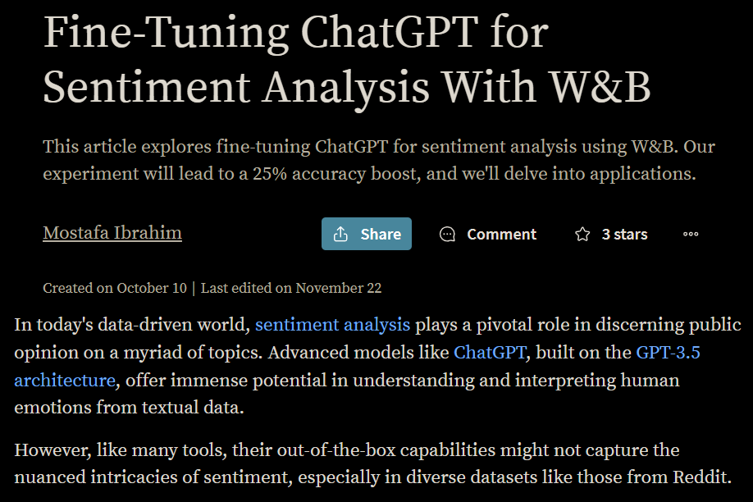
Notes:
https://wandb.ai/mostafaibrahim17/ml-articles/reports/Fine-Tuning-ChatGPT-for-Sentiment-Analysis-With-W-B--Vmlldzo1NjMzMjQx

Slide 62
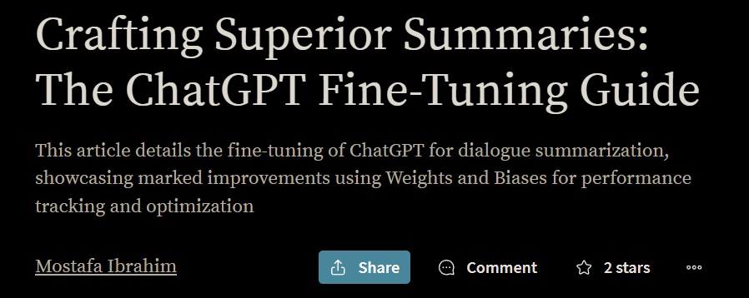
Notes:
https://wandb.ai/mostafaibrahim17/ml-articles/reports/Crafting-Superior-Summaries-The-ChatGPT-Fine-Tuning-Guide--Vmlldzo1Njc5NDI1

Slide 63
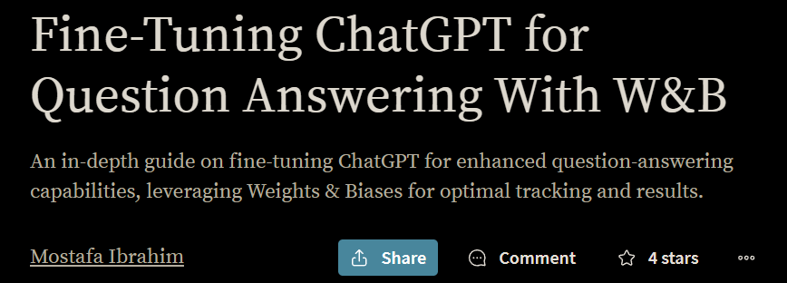
Notes:
https://wandb.ai/mostafaibrahim17/ml-articles/reports/Fine-Tuning-ChatGPT-for-Question-Answering-With-W-B--Vmlldzo1NTEzNjU2

Slide 64
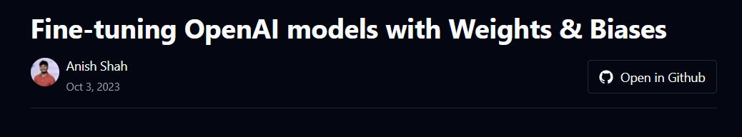
Domain Specific Fine-Tuning: Legal
Notes:
https://cookbook.openai.com/examples/third_party/gpt_finetuning_with_wandb

Slide 65
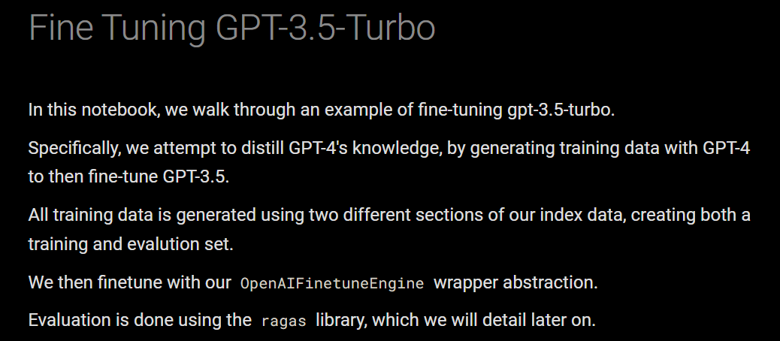
Fine Tuning a Smaller Model from a Larger Model’s Data
Notes:
https://docs.llamaindex.ai/en/stable/examples/finetuning/openai_fine_tuning/

Slide 66


